Slide 1


Business Problem 3 – Super Market in Europe

Slide 2

Business Problem:
You have been hired by the Super Market in Europe as a Tableau Developer.
Your first assignment is to deliver a dashboard with Map view of profit margin and a scatter plot which has details about customer which will help business to find the profitable customers by State using action filter.
Create an interactive dashboard which will help business to take quick decisions in no time.
Also help business to educate what is the difference between Action filters and Highlighting.
What we will learn today
Maps – Filled Maps and Symbol Maps
Scatter Plot
Action Filters – Menu, Select and Hover
Highlight
How to create dashboards in Tableau

Slide 3
Tip of the day – Custom Palettes
Powered by Stay Ahead
We Build Network!!!

Slide 4
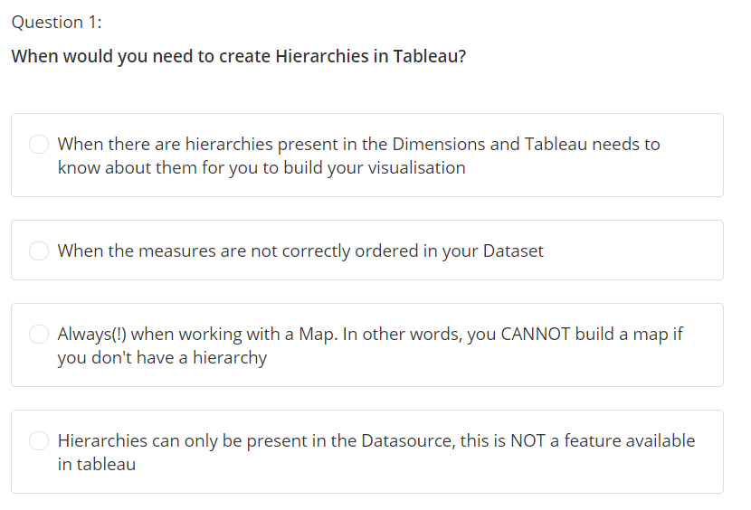

Slide 5
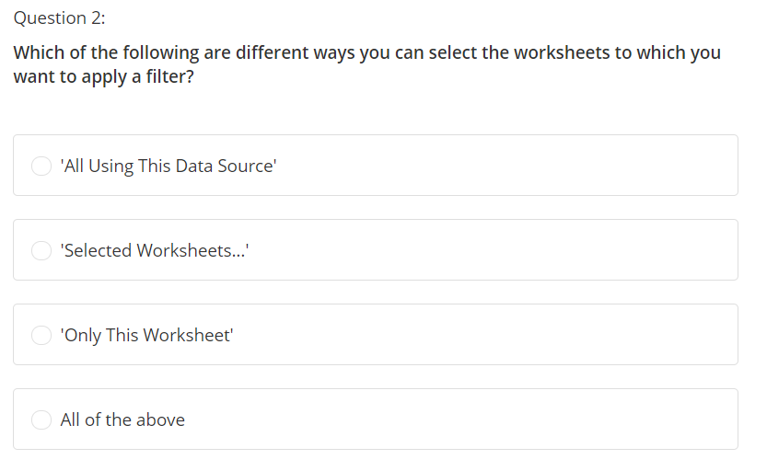

Slide 6
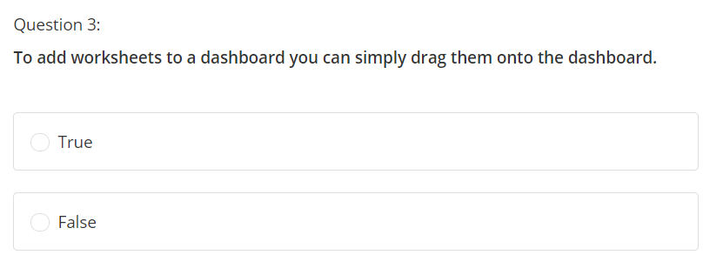

Slide 7
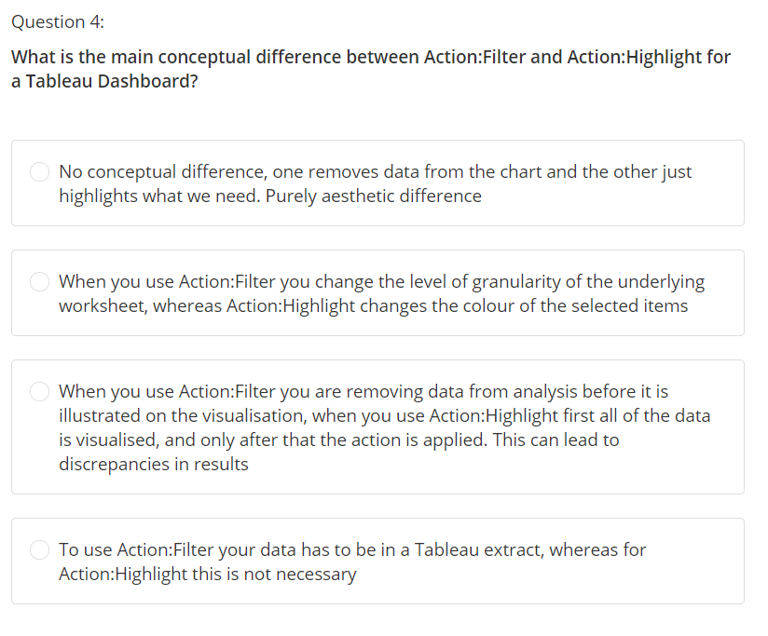

Slide 8
